Slide 1
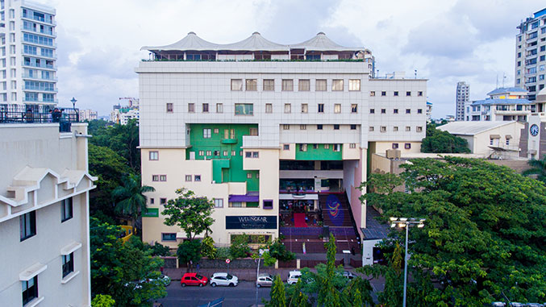




Slide 2
PROBLEM STATEMENT Analysing profiles of 2019 general election candidates using attributes like criminal cases, caste category etc

Slide 3
TEAM MEMBERS:-
Kartik Gundawar
Saurabh Ninave
Aditya Ajgaokar
Kunal Pandey

Slide 4
SOLUTION OVERVIEW:-
1. Crime Count in different states
2. The Educational Qualification of the Candidates
3. Education vs Criminal CASE
4. Male vs Female candidates
5. Candidate Allocation in Lok Sabha Election 2019
6. Party vs Candidates with Crime Case
7. Age vs criminal cases

Slide 5
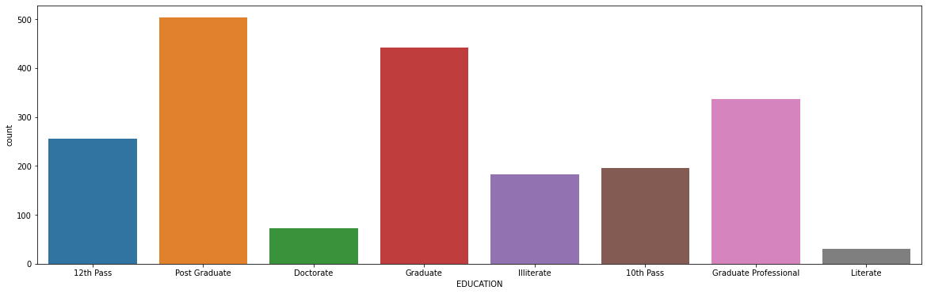
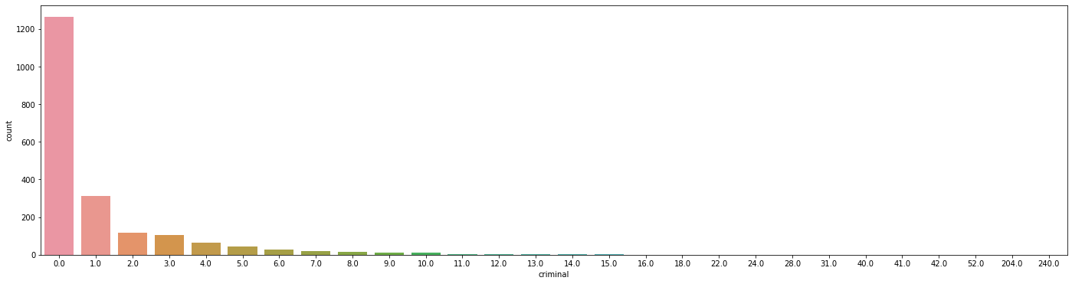
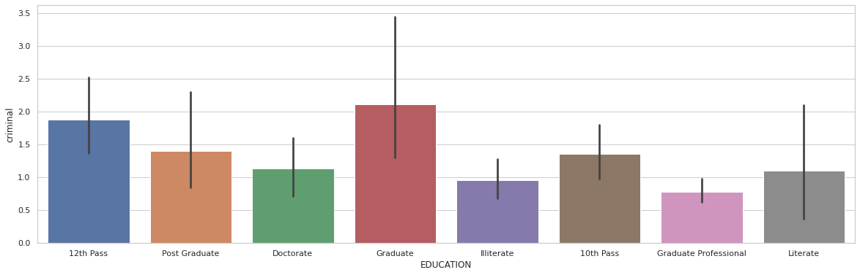
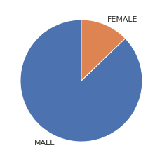
SOLUTION OVERVIEW GRAPHS
1. Crime Count in different states
2. The Educational Qualification of the Ca
3. Education vs Criminal CASE
4. Male vs Female candidates

Slide 6
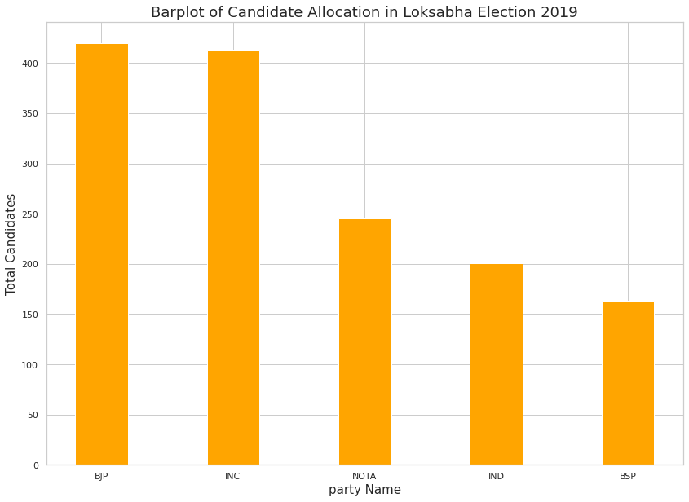
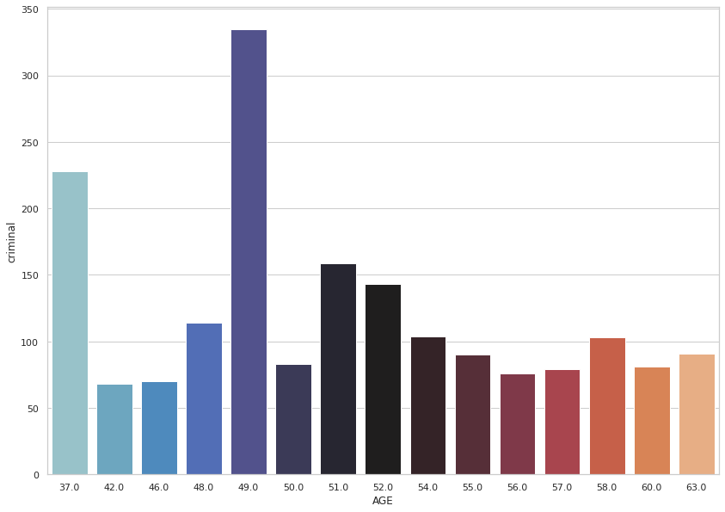
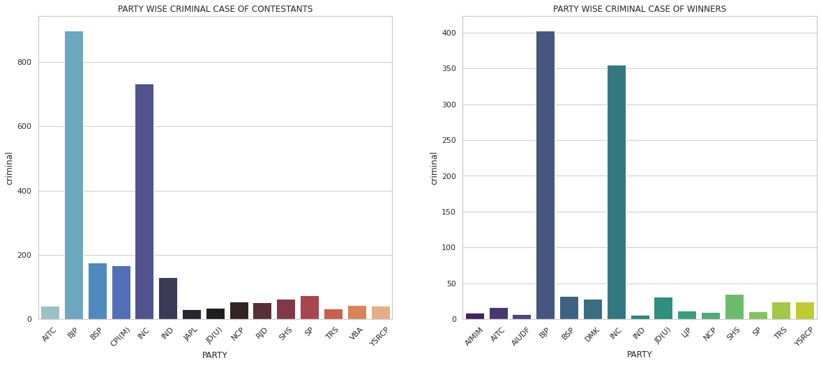
5. Candidate Allocation in Lok Sabha Election 2019
7. Age vs criminal cases
6. Party vs Candidates with Crime Case

Slide 7
DETAILED WORKING
We imported the dataset from the CSV file and described the data to understand its overview.
Then we found out the correlations between each variable in data to establish a relationship between the variables.
We checked for null values in the Criminal Cases to clean the data. Then we checked for the total number of criminal cases against an MP in individual states.
We analysed the crime count and educations data of candidates from different states by drawing two Bar Plots.
We replaced the 5th pass and 8th pass education qualification with illiterate, and then we created a bar plot for education data to count the number of candidates with specific education.
Then we replaced the null value in the Criminal Case column with 0.

Slide 8
Further, we tried to establish a relation between Education Qualification and the number of criminal cases.
We created a pie chart to understand the male to female ratio of candidates.
Next, we created a bar plot to find the state with the maximum number of criminal cases.
Then we calculated the candidates with criminal cases in different parties.
Then we tried to understand the relationship between age and criminal cases.
We created a bar plot between party names and total candidates to calculate the total number of allocations of candidates from different parties in different constituencies in India.
Next, we calculated the number of candidates from varied categories.

